Slide 1
AN INVESTMENT PERSPECTIVE OF HUMAN RESOURCE MANAGEMENT

Slide 2
The Strategic View of Human Resources
Employees are human assets
Increase in value to organization and marketplace when investments of appropriate policies & programs are applied
Effective organizations recognize that employees have value
Much as organization’s physical & capital assets have value
Employees are valuable source of sustainable competitive advantage

Slide 3
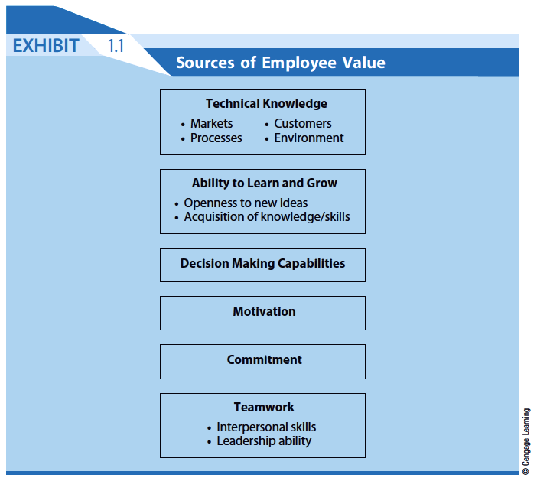

Slide 4
Sources of Employee Value
Technical Knowledge
Markets, processes, customers, environment
Ability to Learn and Grow
Openness to new ideas
Acquisition of knowledge & skills
Decision Making Capabilities
Motivation
Commitment
Teamwork
Interpersonal skills, leadership ability

Slide 5
Adopting an Investment Perspective
Determines how to best invest in people
Costs
Out-of-pocket
Opportunity
Human assets become competitive advantage
Required skills become less manual, more knowledge-based
Appropriate, integrated, strategy-consistent approach is needed

Slide 6
A Dilemma
Failure to invest in employees causes
Inefficiency
Weakening of organization’s competitive position
Human assets are risky investment
Require extra effort to ensure that they are not lost

Slide 7
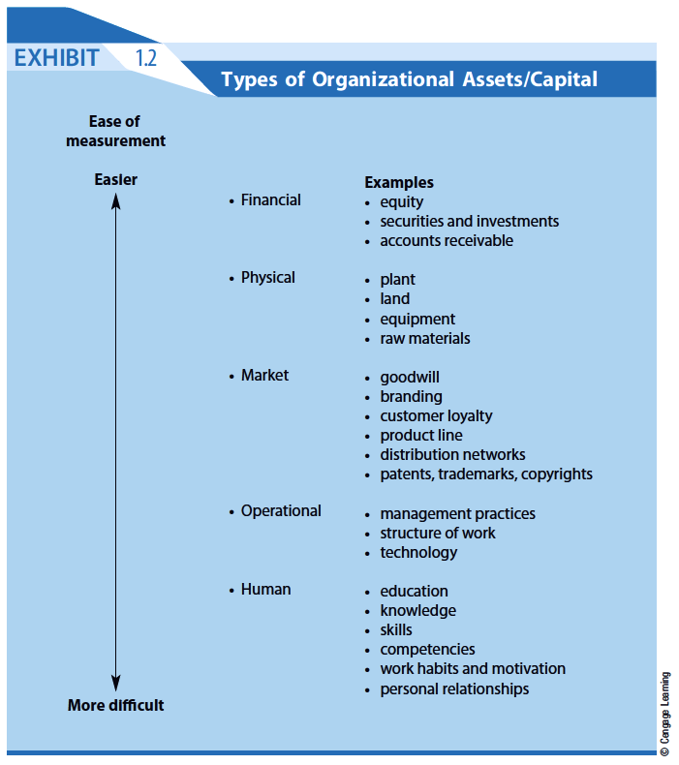

Slide 8
Research Findings
HR practices directly related to profitability & market value
Primary reason for profitability:
Effective management of human capital
Integrated management of human capital can result in 47% increase in market value
Top 10% of organizations studied experienced 391% return on investment in management of human capital

Slide 9
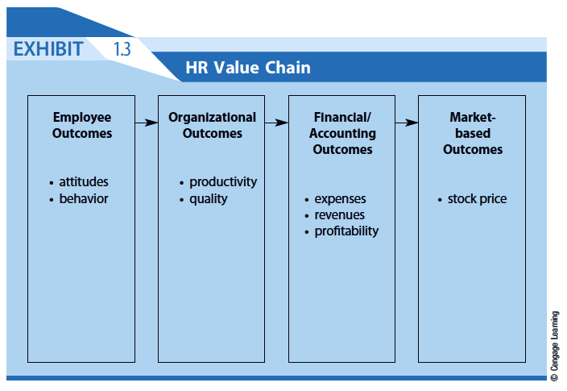

Slide 10
HUMAN RESOURCE METRICS
Wall Street analysts still generally fail to acknowledge human capital in assessing the value of an organization and the effect that human resources can have on stock price
This is rooted in the fact that there are no “standard” metrics or measures of human capital, much as there are for other organizational assets
Exhibit 1.4 lists some Common HR Metrics while Exhibit 1.5 displays the means of calculating five common metrics. However, the appropriate metrics for any given organization will be dependant on that organization’s strategy.

Slide 11
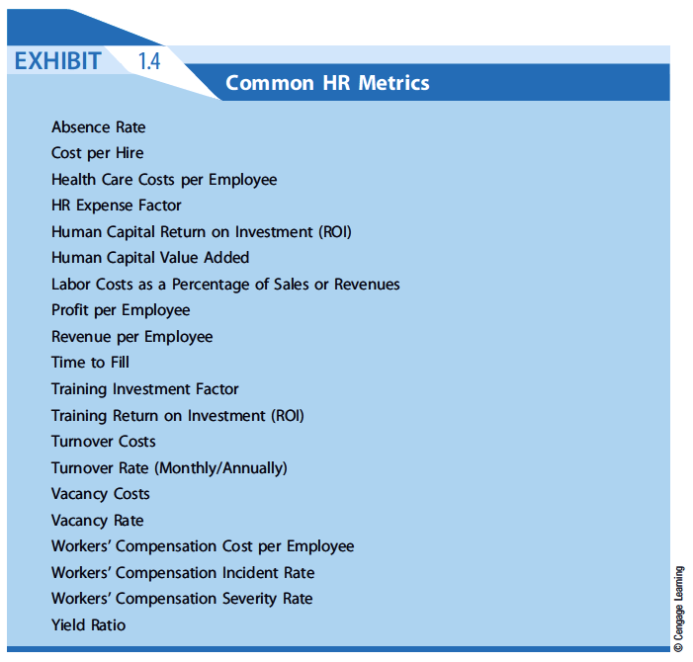

Slide 12
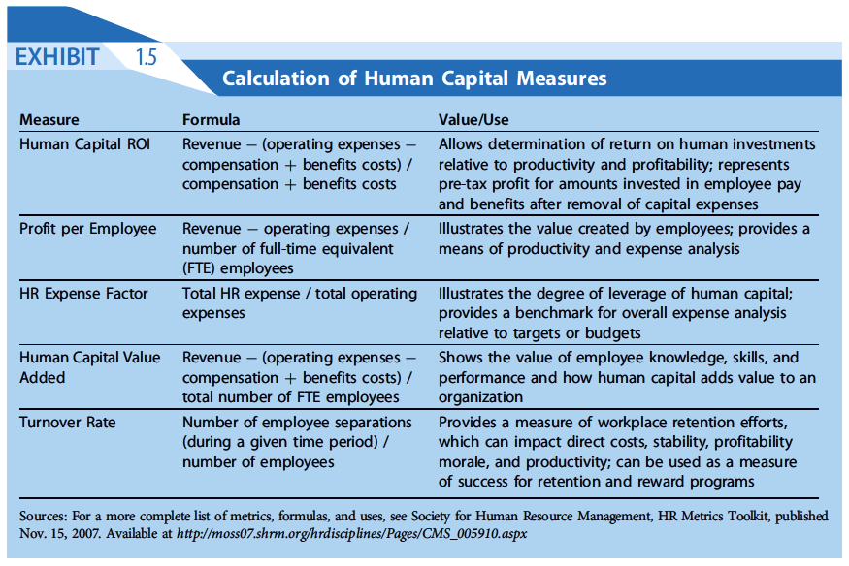

Slide 13
HR Metrics Are Complex
90% of Fortune 500 organizations evaluate HR operations on basis of three metrics:
Employee retention and turnover
Corporate morale
Employee satisfaction
These metrics do not necessarily illustrate how HR impacts
Profits
Shareholder value

Slide 14
Mercer Model of Measuring HR Impact
Identify problem HR can impact
Calculate actual cost of problem
Choose HR solution that addresses problem
Calculate cost of solution
Calculate value of improvement 6 to 24 months after implementation
Calculate specific return on investment
ROI in human assets often not realized until some time in future

Slide 15
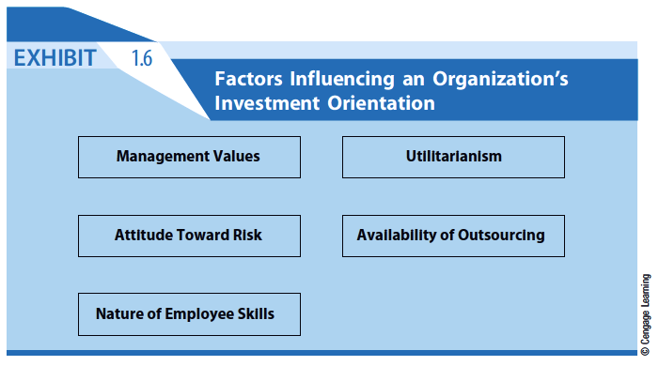

Slide 16
Investment-Oriented Organization
Sees people as central to mission & strategy
Mission statement & strategic objectives espouse value of human assets in achieving goals
Management philosophy encouraging development & retention of human assets
Does not treat human assets in same ways as physical assets

Slide 17
Investment Orientation Factors
Senior Management Values & Actions
Managers need “investment orientation” toward people
Attitude Toward Risk
Investment in human resources inherently riskier
Human assets never absolutely “owned”
Nature of Skills Needed by Employees
The more marketable employee skills, the riskier the firm’s investment in skill development

Slide 18
Investment Orientation Factors
Utilitarian (“Bottom Line”) Mentality
Attempt made to quantify employee worth through cost-benefit analysis
“Soft” benefits of HR programs difficult to objectively quantify
Availability of Outsourcing
Given availability of cost-effective outsourcing, investments in HR should produce highest returns & sustainable competitive advantages.

